Slide 1

GITAM (Deemed to be university) School of Technology, Hyderabad Department of Computer Science and Engineering
Synthetic Human Face Generation Using Deep Convolutional Generative Adversarial Networks (DCGAN)
Project Batch No: P14-05
R Thaneesh Varma- HU21CSEN0300408
P Nikhil Krishna- HU21CSEN0300328
S Jatin Chandra- HU21CSEN0300338
K Pranav- HU21CSEN0300429
Guide Name:
Dr. Rajib Debnath

Slide 2
CONTENTS
Introduction
Review of literature Survey
Literature summary
Datasets
Problem statement
Event flow
References

Slide 3

INTRODUCTION
The project focuses on generating realistic human faces using these models.
The project utilizes Deep Convolutional Generative Adversarial Networks (DCGANs).
DCGANs are a powerful class of generative models for creating high-quality images.
The goal is to train a DCGAN on a dataset of human faces.
The model will then generate new, artificial yet lifelike faces.
These generated faces do not correspond to real individuals.
The faces showcase the model's ability to mimic reality through its intricate learning process.

Slide 4
REVIEW OF LITERATURE SURVEY
Publication Details | Abstract | Data set | Algorithm | Results | Observations | Research Gap
From Attributes to faces: a conditional generative network for face generation. 2018 by the Gesellschaft für Informatik e.V., Bonn, Germany Yaohmi Wang, Anitza Dantcheva, Francois Bermond | The paper explores generating realistic faces from attribute labels using a deep conditional GAN (DCGAN), evaluated with GAN-quality metrics, face detectors, and a commercial attribute classifier. | Celeb A | Deep Convolution Generative Adversarial Network (DCGAN) | 89.1% for two attributes 96% for five attributes using the DFace detector. For gender classification using Face++, 81.8% when generating faces with five attributes. | Binary age labels limit accuracy, producing "older" or "younger" faces but not exact ages. Faces with 5 attributes appeared more realistic than those with 2. Mode collapse reduced when using Spectral Normalization | 1.Mode collapse during training, worsened by Batch Normalization in the discriminator, affects stability and output quality. 2. Binary attribute labels, like age, and reliance on altered celebrity images, limit the accuracy of generated faces.

Slide 5
REVIEW OF LITERATURE SURVEY
Publication Details | Abstract | Data set | Algorithm | Results | Observations | Research Gap
GAN Generated Fake Human Face Image Detection 2024 (IITCEE) Swati Shilaskar Mayur Talewar Soham Tak Sidhesh Goud | 1. CNN model accurately detects GAN-generated fake human faces, outperforming existing methods. 2. Ideal for social media platforms to combat deepfakes. | Real Images: 70k images from the FFHQ (Flickr-Faces-HQ) dataset by NVIDIA. Fake Images: 70k images generated using StyleGAN3. Res: 1024*1024 | Convolutional Neural Network (CNN) | Discriminator Accuracy at Epoch 5: 99.42%. Accuracy at 1 Epoch: 82.37% At 2: 93.5% At 3: 97.84% At 4: 99.22% | The proposed CNN architecture enhances detection of StyleGAN3- generated fake faces, outperforming existing systems, and can be integrated into social media for identifying fake profile pictures and deepfakes. | Mode Collapse due to usage of high accuracy CNN as Discriminator. (Overpowered Discriminator) When Discriminator accuracy is too high, Overall GAN results tend to look fake.

Slide 6
REVIEW OF LITERATURE SURVEY
Publication Details | Abstract | Data set | Algorithm | Results | Observations | Research Gap
Performance of DCGAN in 3D Face Reconstruction IEEE Access journal in the year 2023. Kriti Gupta, Meenu Gupta,Rakesh Kumar, Ahmed J. Obaid | The study assesses DCGANs for 3D face reconstruction in VR and biometrics, highlighting limitations with human faces. Using datasets like FaceWarehouse and CelebA, it suggests combining DCGANs with transfer learning and landmark recognition to enhance accuracy and realism. | This study utilizes the following three datasets: - FaceWarehouse - Prosopo Dataset - CelebA | Deep Convolutional Generative Adversarial Network (DCGAN) | Accuracy in MSE (Mean Squared Error) FaceWarehouse: 0.074 (epoch 5), 0.092 (epoch 50) Prospo: 0.112 (epoch 5), 0.132 (epoch 50) CelebA: 0.112 (epoch 5), 0.132 (epoch 50) Lower MSE indicates better performance, though no direct percentage is provided. | Deep Convolutional GANs can effectively create 3D facial models from 2D images, with better results after more training. Performance depends on the dataset, and combining GANs with landmark recognition could improve accuracy. The technique holds promise for VR and biometrics but needs refinement. | - DCGANs struggle with 3D human face reconstruction. - Perform well on animal faces. - Proposed: Use transfer learning and landmark recognition for improvement. - Need for hybrid models to enhance accuracy.

Slide 7
REVIEW OF LITERATURE SURVEY
Publication Details | Abstract | Data set | Algorithm | Results | Observations | Research Gap
Facial Image Generation from Bangla Textual Description using DCGAN and Bangla FastText Noor Mairukh Khan Arnob, Nakiba Nuren Rahman, Saiyara Mahmud, Md. Nahiyan Uddin, Rashik Rahman*, Aloke Kumar Saha* (IJACSA) International Journal of Advanced Computer Science and Applications | A system generating facial images from Bangla text using the CelebA Bangla dataset and a DCGAN. It leverages Bangla FastText embeddings to enhance accuracy | CelebA Bangla | DCGAN (Deep Convolutional Generative Adversarial Network) | The performance results for Model-1 (Architecture: DCGAN + Bangla FastText) FID: 126.71 (lower is better) Inception Score: 12.361 (higher is better) LPIPS: 21.83 (lower is better) FSD: 20.23 (lower is better) FSS: 0.343 (higher is better) Conclusion: Model-1 outperformed other models in the study based on these key metrics. | The paper introduces the CelebA Bangla dataset and utilizes Bangla Fast Text embeddings to improve the accuracy of generating facial images from Bangla text. It showcases the potential of DCGANs for low-resource languages, advancing research and promoting language diversity in AI. | The paper notes that the generated images often lack sharpness and detail due to the small size of the CelebA Bangla dataset. The model also has trouble capturing subtle variations in Bangla text, affecting accuracy. Standard metrics like Inception Score and FID may not fully capture performance, and limited resources for Bangla constrain progress.

Slide 8






LITERATURE SUMMARY
Focus: Leveraging GANs for realistic human face generation across multiple tasks.
Key Algorithms: DCGAN, CGAN, and advanced variants (SyncGAN, CMCGAN) for better control and synthesis.
Datasets: CelebA, AR dataset, MS1MV2, synE2F – widely used for face generation.
Challenges: Training instability, mode collapse, dataset limitations, and computational costs.
Successes: Achieved >90% accuracy in some models; perceptual quality enhanced for human acceptance.
Limitations: High resource demand and limited dataset generalization.

Slide 9
DATASETS/ALGORITHM USED
Complete Literature Review
Data Set | Algorithm | Accuracy
FFHQ (Flickr-Faces-HQ) dataset by NVIDIA | Convolutional Neural Network (CNN) architecture with StyleGAN3 | 99.42% (Discriminator)
CelebA Bangla | Deep Convolutional Generative Adversarial Network | No Proper accuracy mentioned
CelebA | DCGAN | 89.1% - two attributes 96% - five attributes 81.8% using Face++ for five attributes
AR Dataset | (Conditional Generative Adversarial Network (C-GAN)) | 91.12%
FaceWarehouse,-Prosopo Datase, CelebA | Deep Convolutional Generative Adversarial Network (DCGAN) | No Proper accuracy mentioned
CelebA | Deep Convolutional Network (DCN) | 82.80%
CelebA | DCGAN | SSIM(0.34) for 500 randomly selected images

Slide 10



PROBLEM STATEMENTS
The primary problem statement when generating human faces using DCGAN is to create realistic and diverse human faces that are indistinguishable from real ones.
Facial Complexity: Capturing intricate features, expressions, and subtle nuances.
Diversity Spectrum: Representing a rich variety of ethnicities, genders, and ages.
Avoiding Mode Collapse: Ensuring the generator produces a broad range of faces, not repetitive ones.

Slide 11
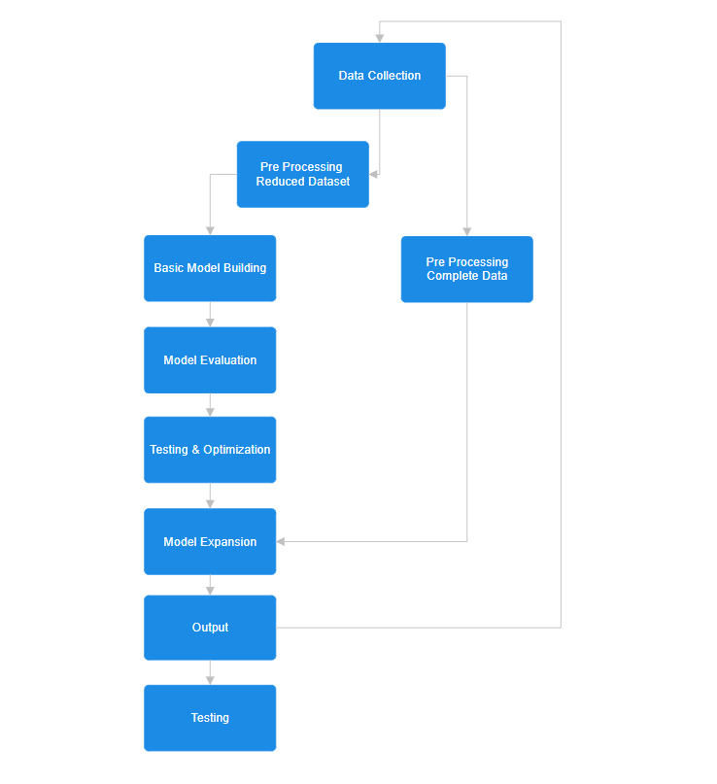

EVENT FLOW

Slide 12

THANK YOU

